Slide 1
Digital
Forensics
9919004368 Vikrant
9919004153 Kunal
November 2021

Slide 2
Table Of Content
Problem Statement
Explanation of Problem
Approach & Tools Used
Reference

Slide 3
Problem Statement
You have acquire a forensic image of a suspect’s laptop. After doing an examination, you discover at least one VM installed, and you think more data can be found, but you aren’t sure. You decide to make a copy of the VM’s file and mount the VM as an external drive. Write the best procedure for this situation

Slide 4
Project Stack
Oracle VM VirtualBox 6.1.28
Forensics OS: Windows 10
Suspect’s VM:
Case1. Remnux vdmk and Case 2. Ubuntu vdi i.e. [victim] (debian based)
Tools:
Autopsy 4.19.1
Md5sum (hashing)
FtkImager

Slide 5
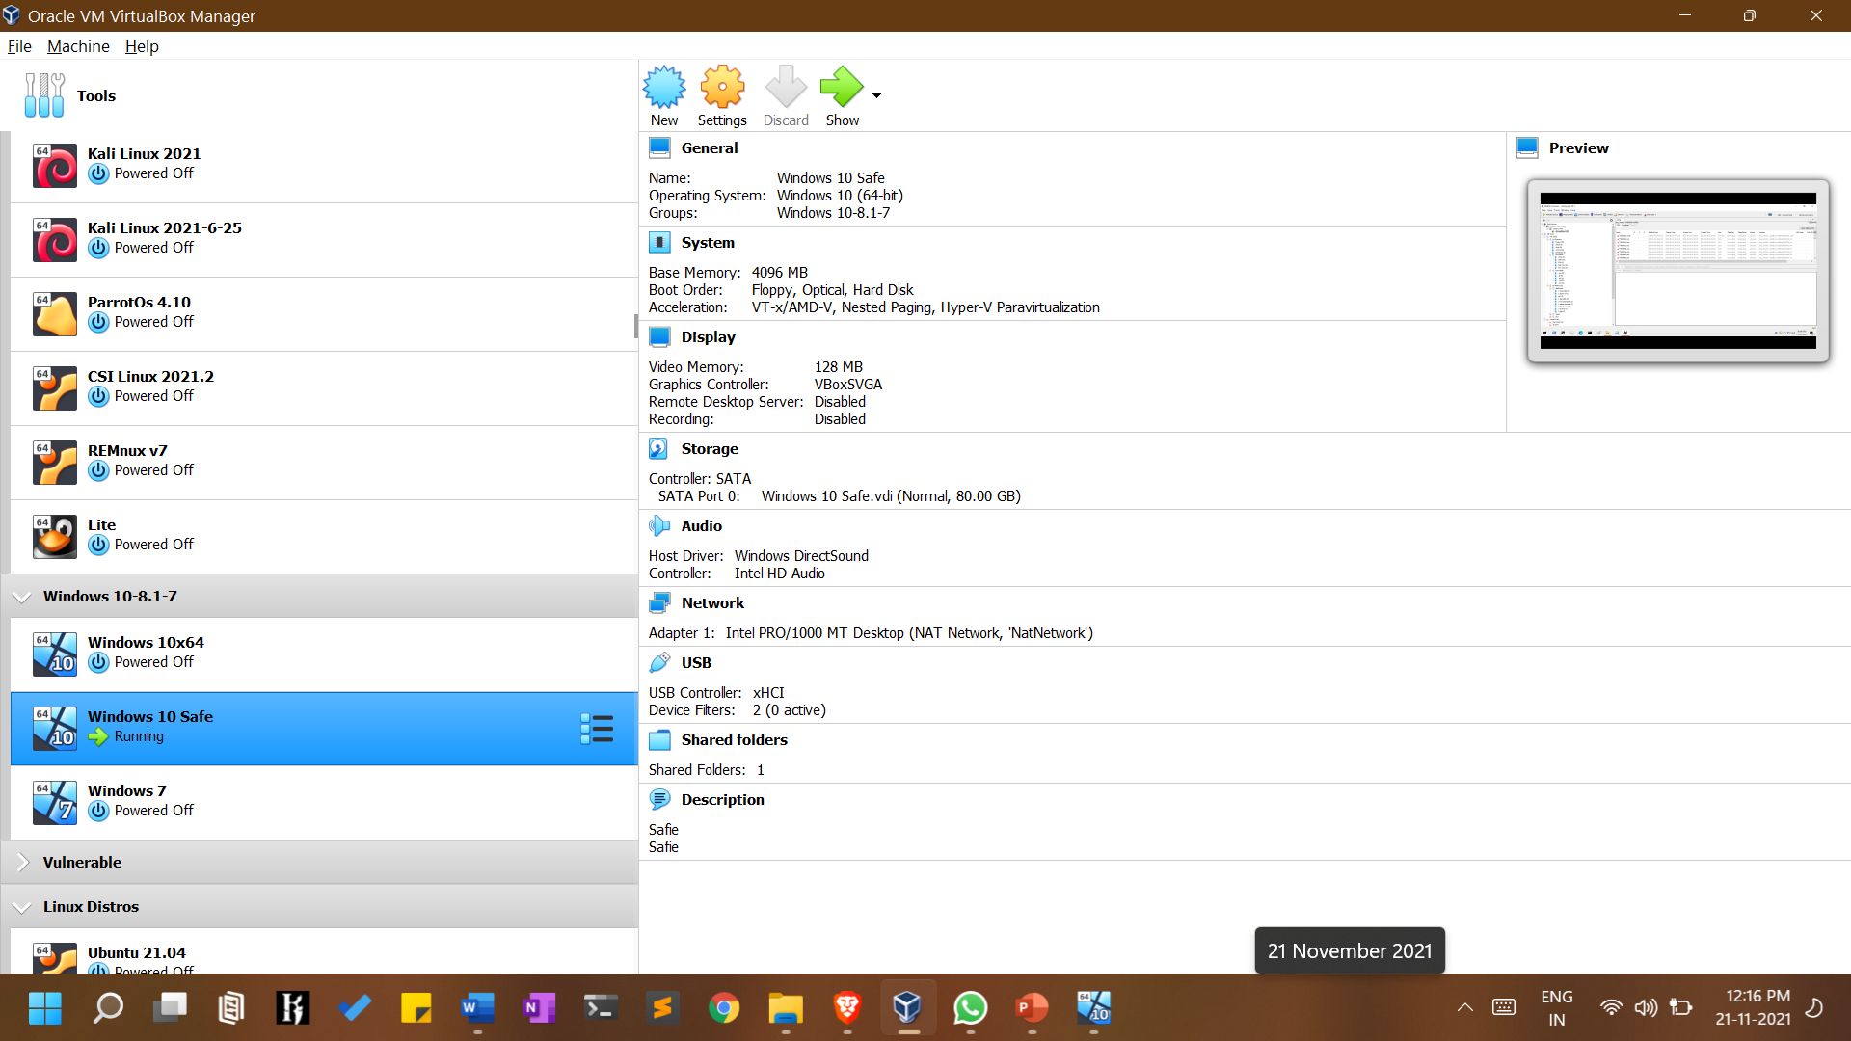

Slide 6
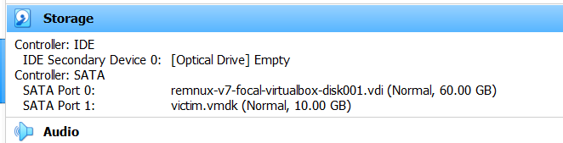
Case 1 : Victim Snapshot of Remnux VDMK

Slide 7
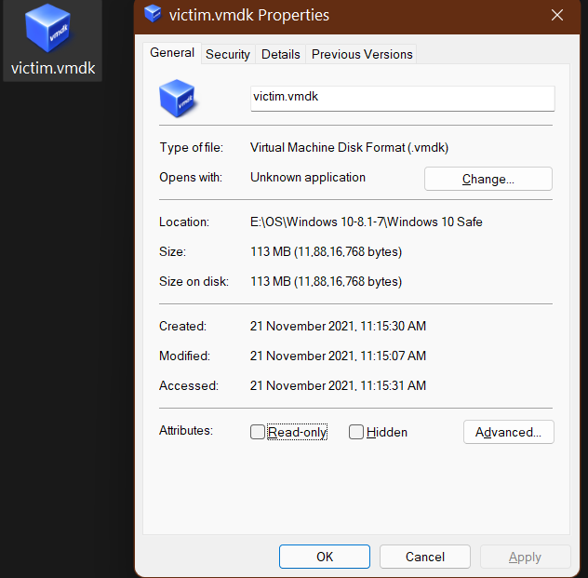
Case1 : Victim Snapshot of Remnux VDMK

Slide 8
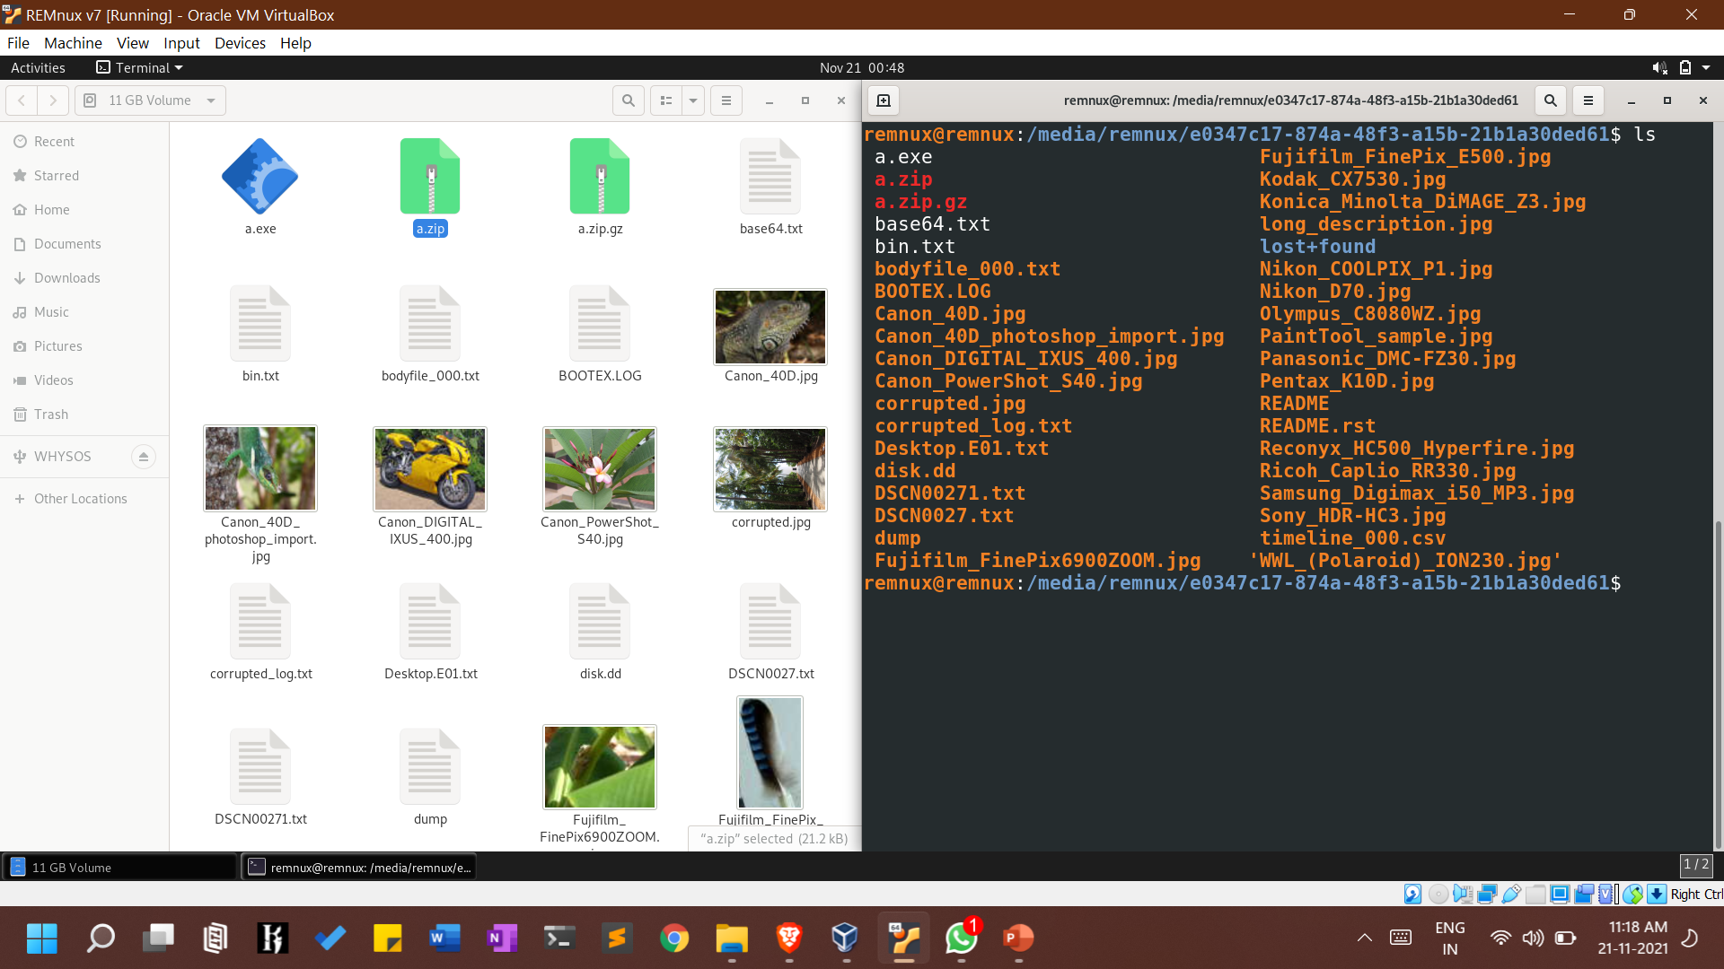
Remnux Os on Vbox ; we do forensics using autopsy 4.19.1

Slide 9
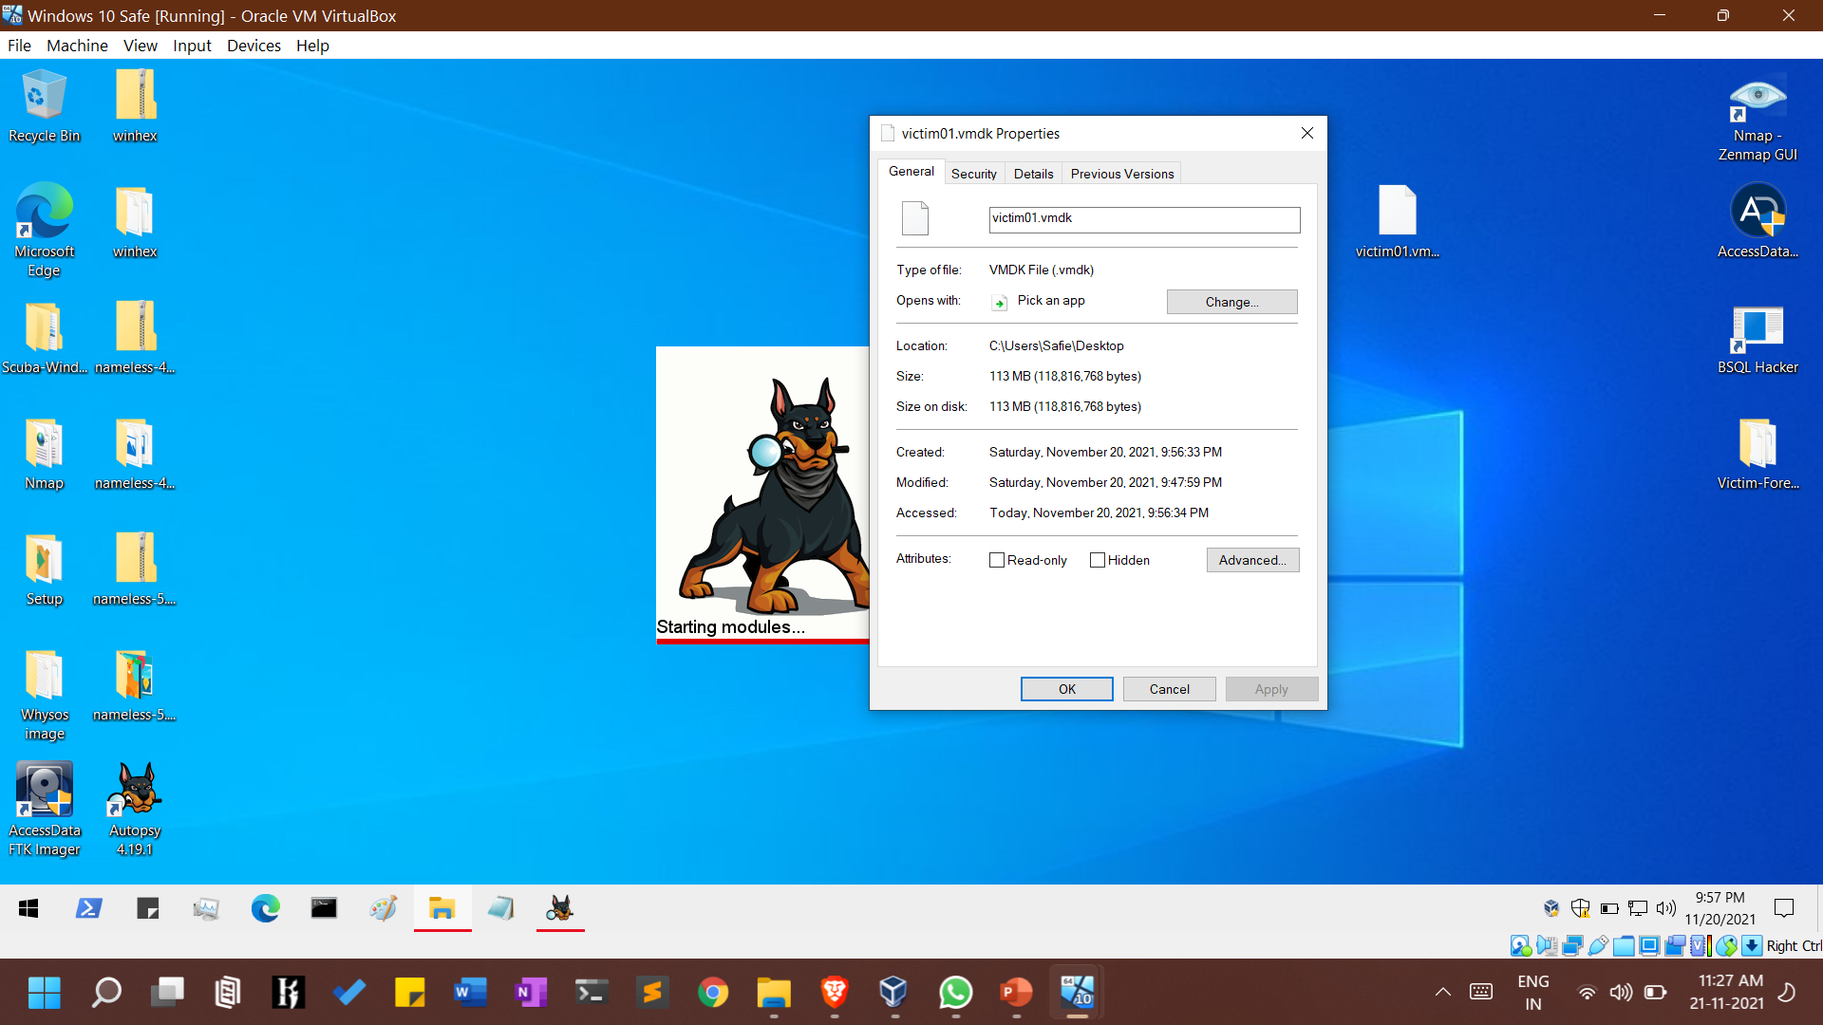
We have copied .vmdk to Forensic Os i.e. Windows 10 Safie

Slide 10
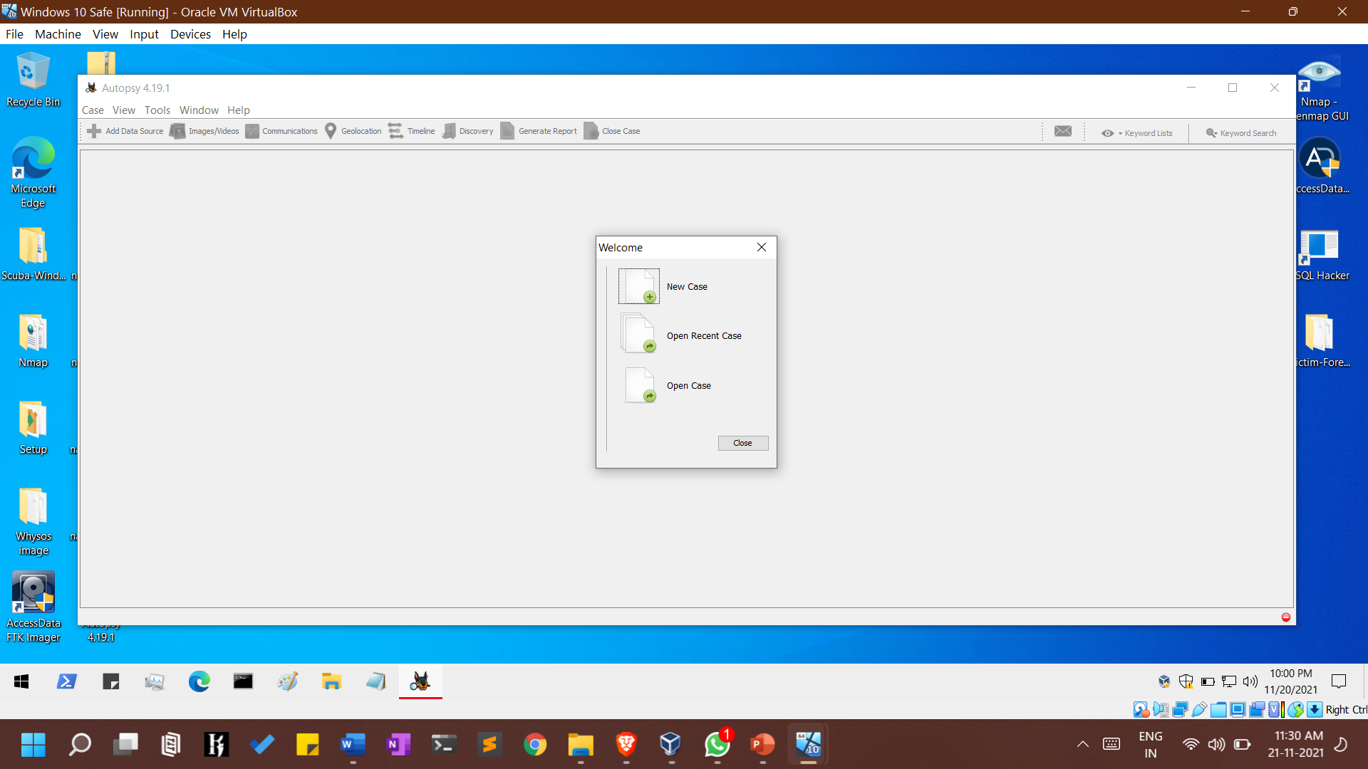
Creating New Case

Slide 11

Filling Info Details

Slide 12


Slide 13
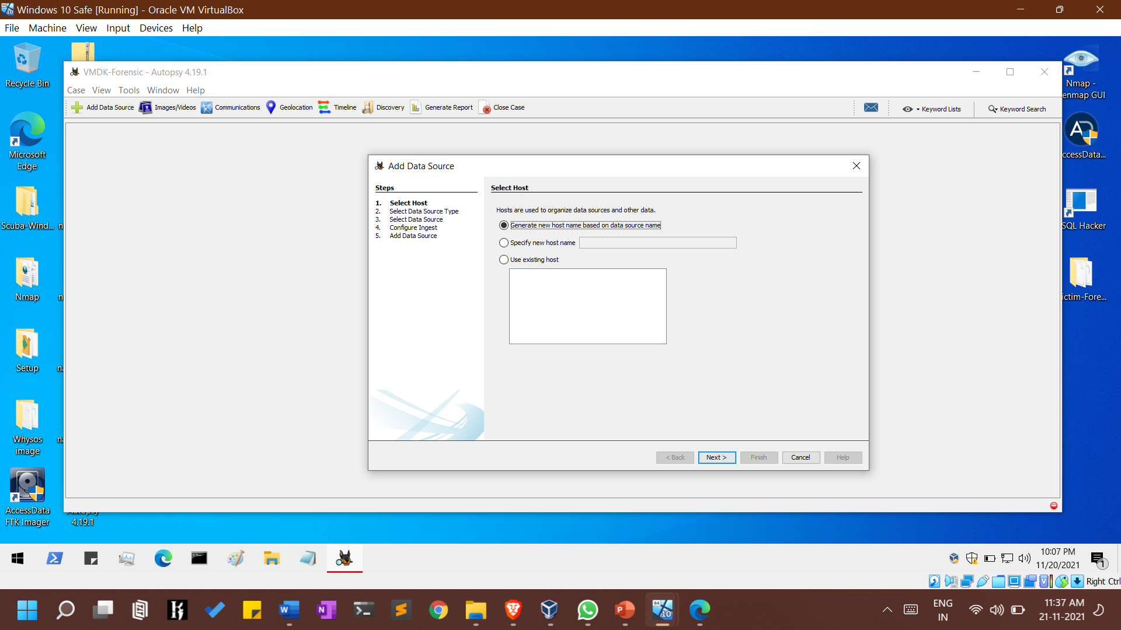
Adding Data Source

Slide 14
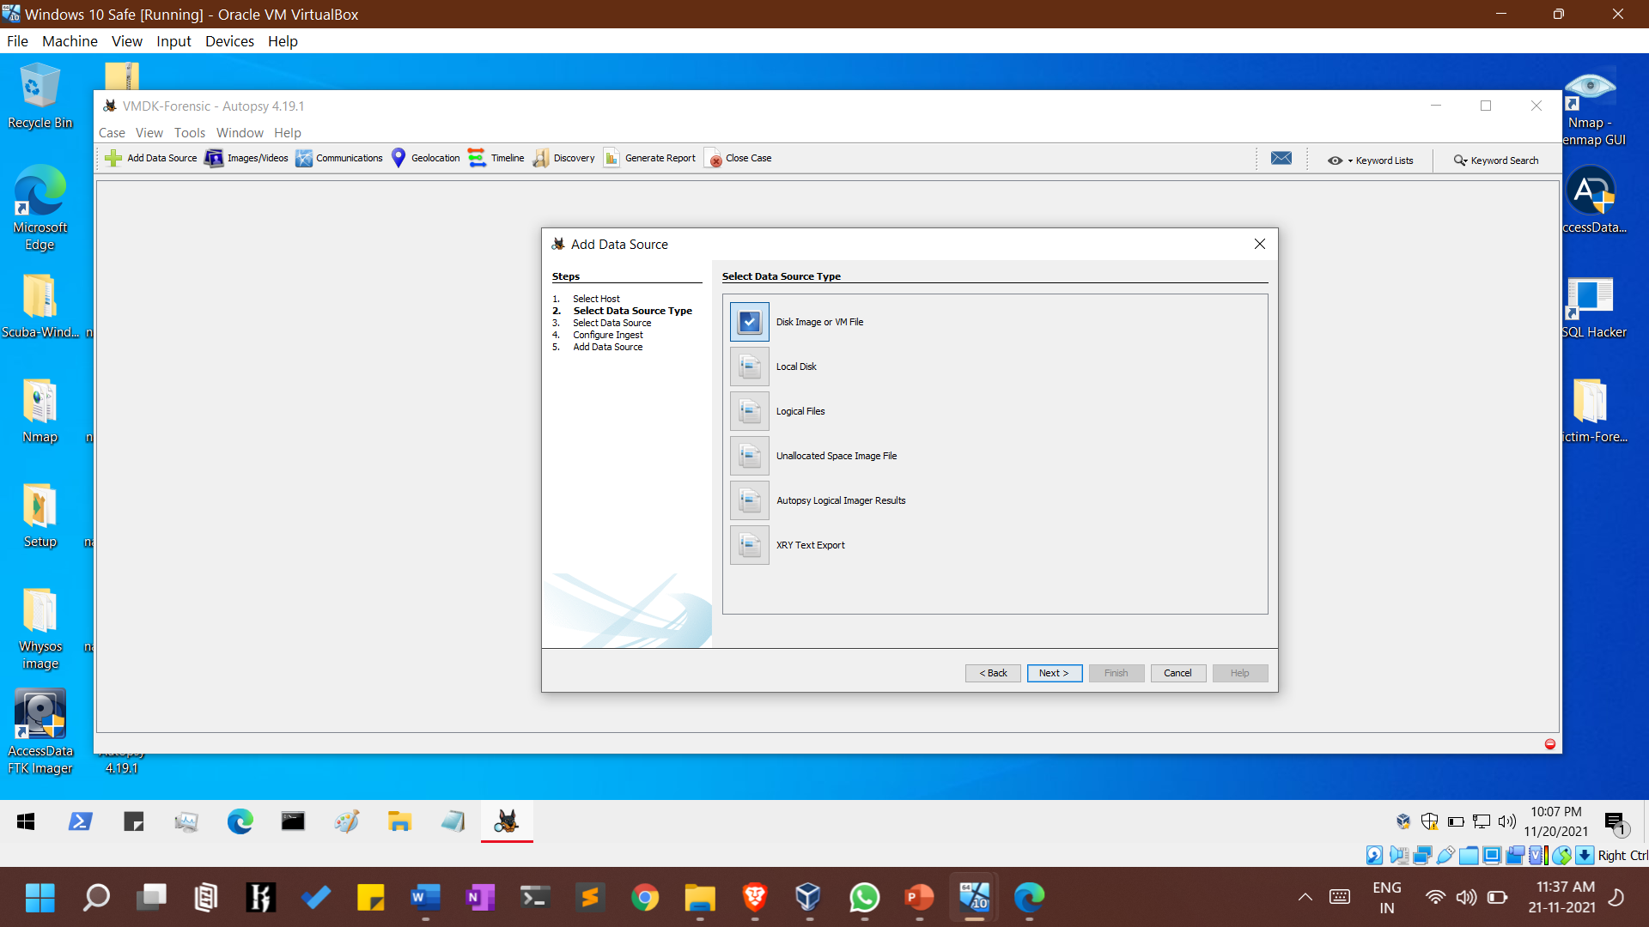
Adding .vmdk , i.e. suspects vm images

Slide 15
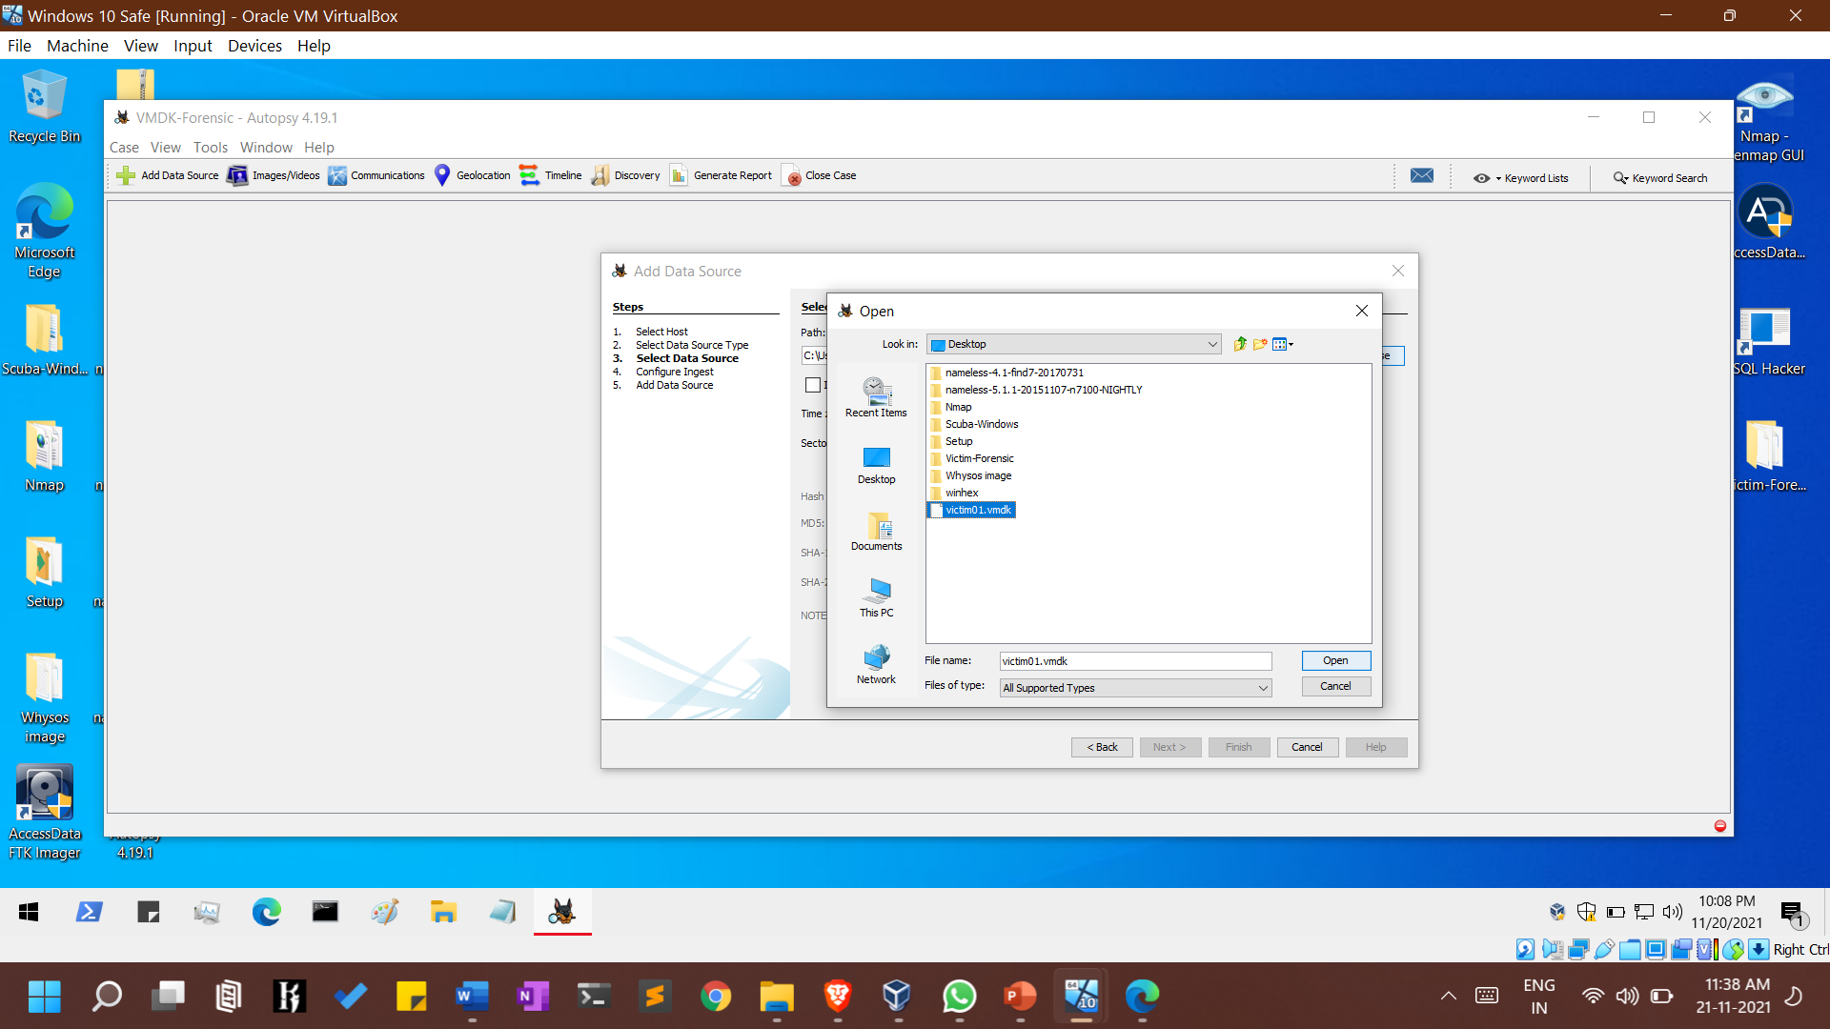

Slide 16

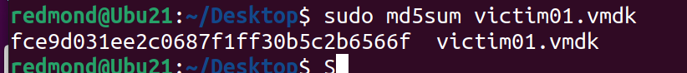
Adding md5 hash by calculating using md5sum

Slide 17
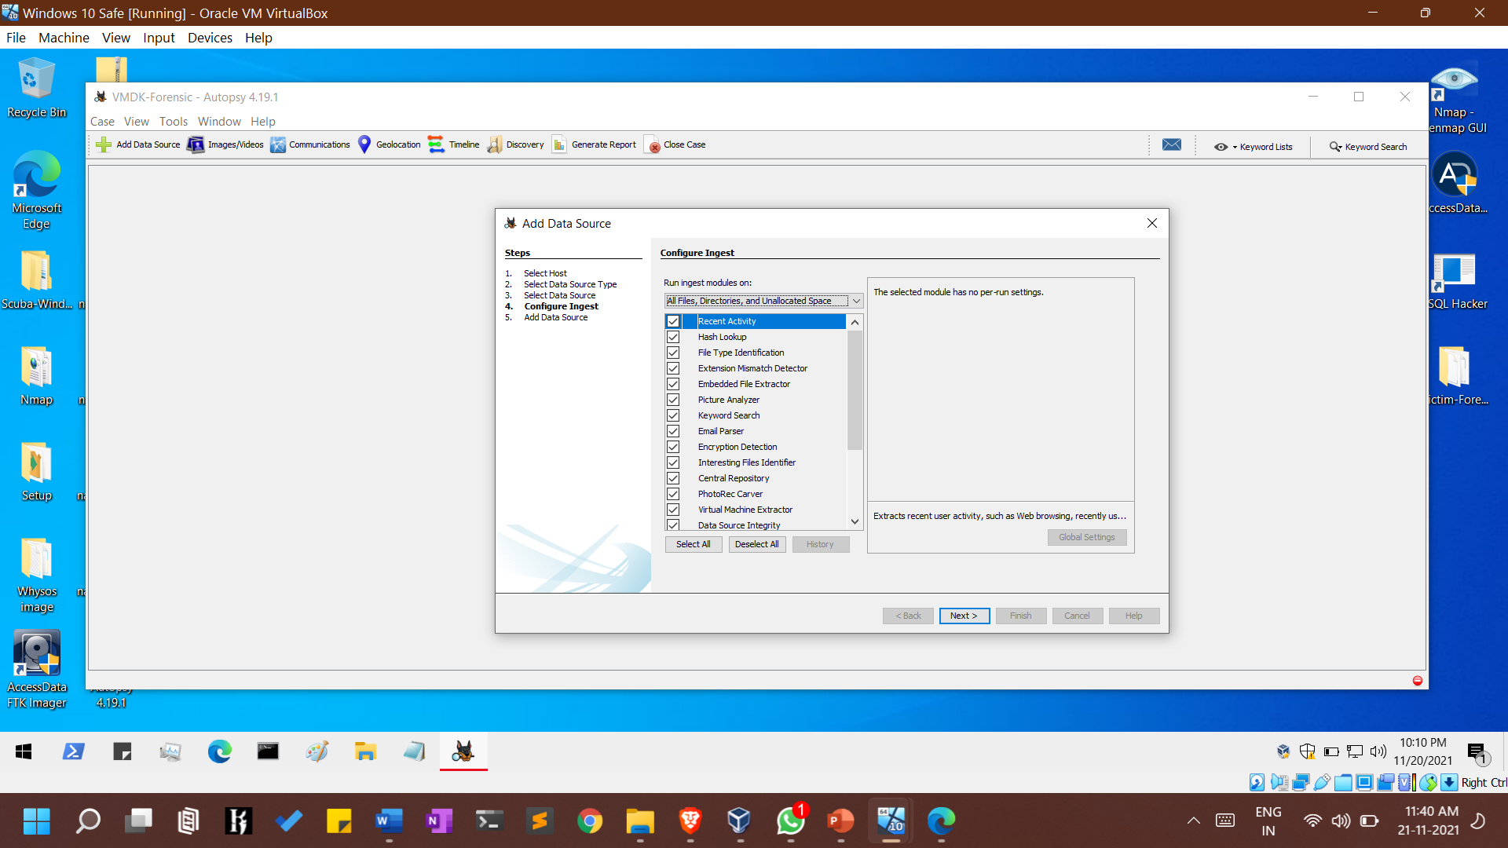
Checking all the recommended ingest [plugins]

Slide 18
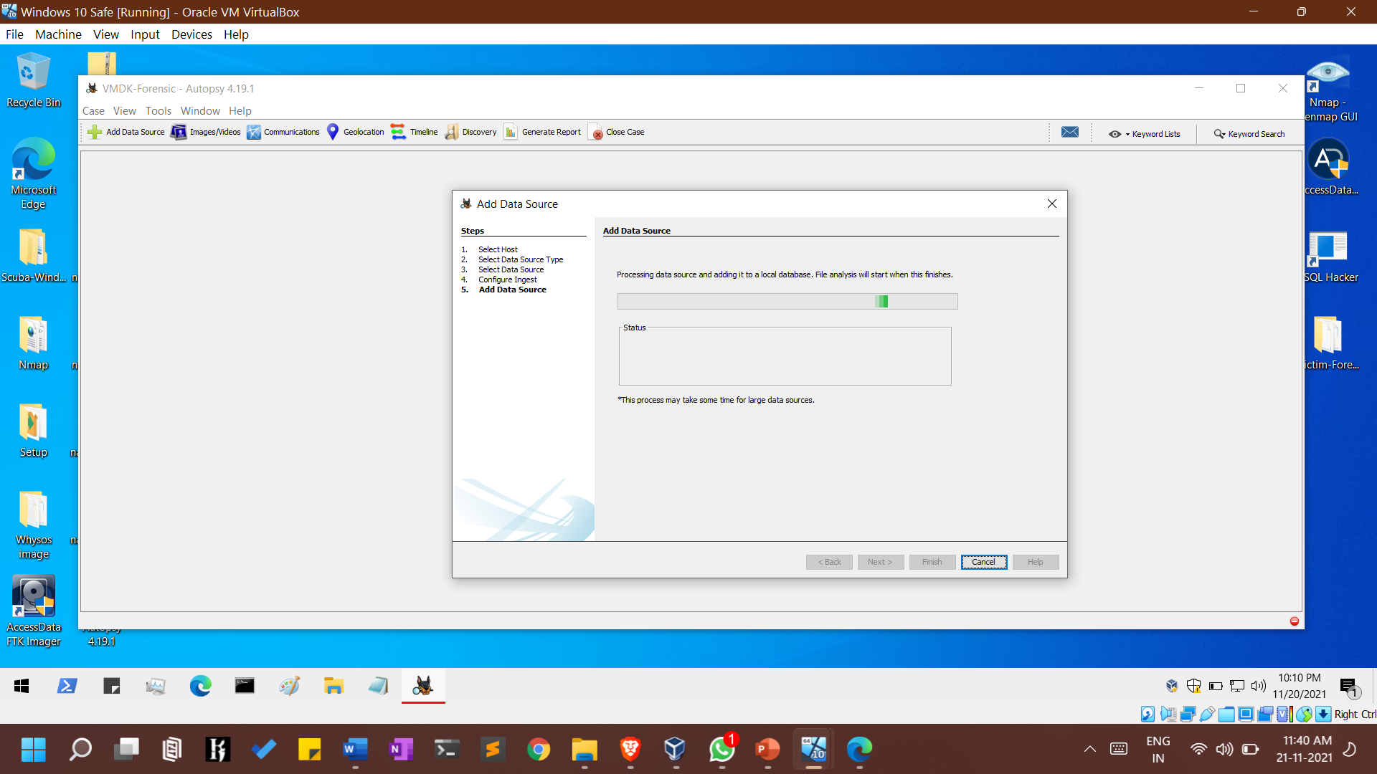

Slide 19
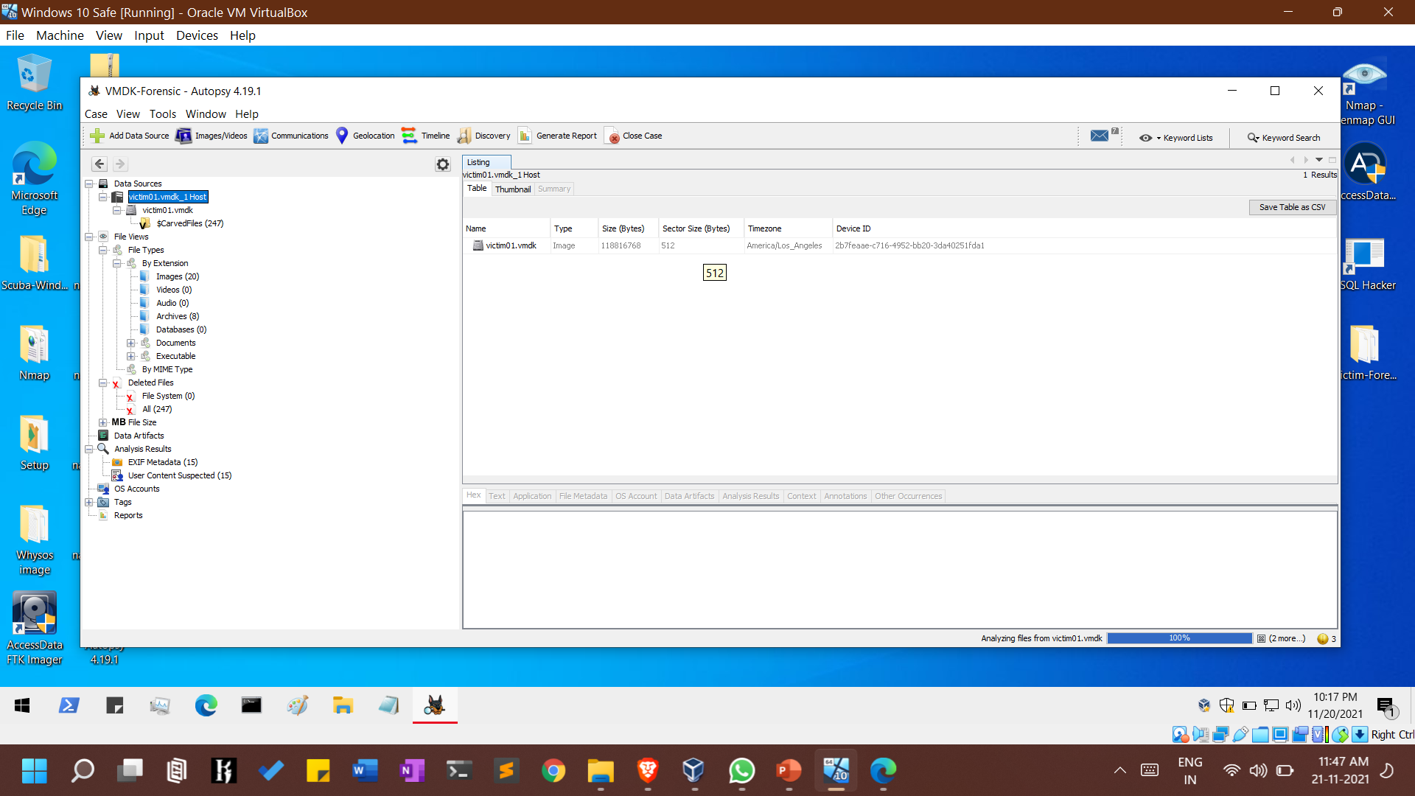
Analysing files process will take some time to show details….. So Patience

Slide 20
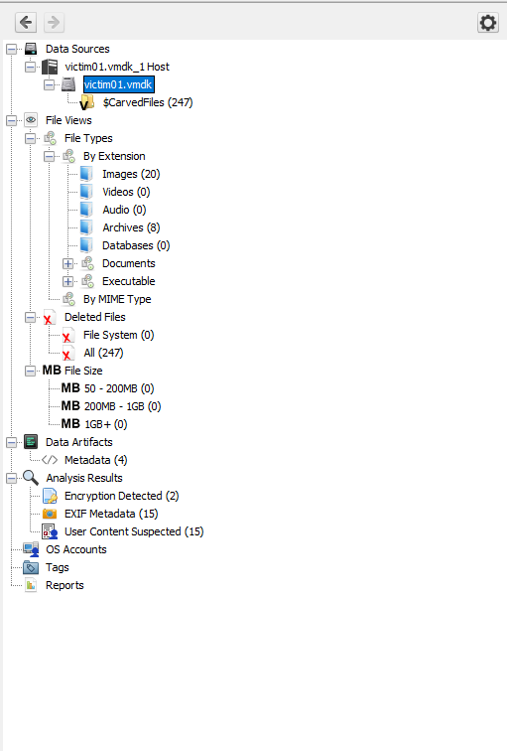
Evidence Tree

Slide 21
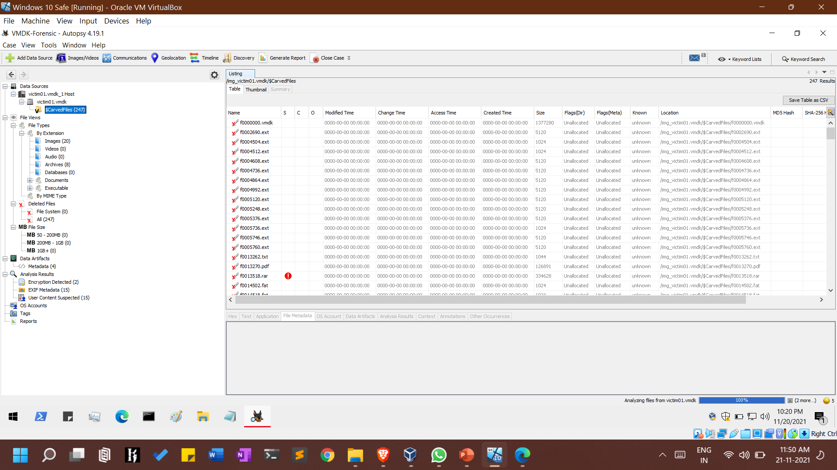
Carved Files

Slide 22
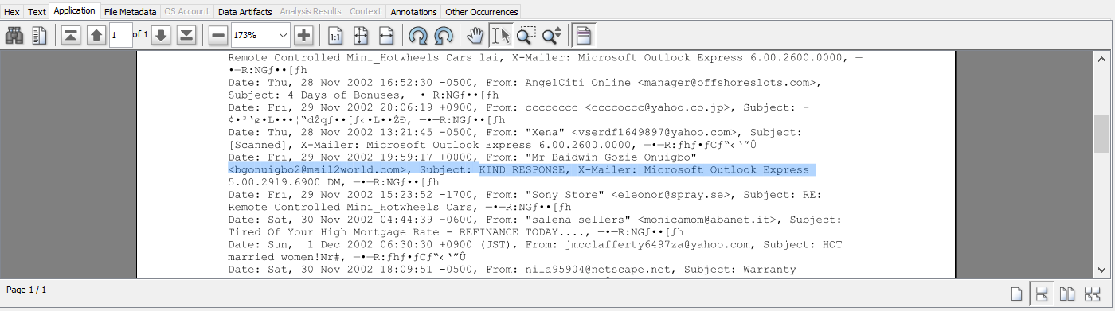
Reading PDF files on vm image

Slide 23
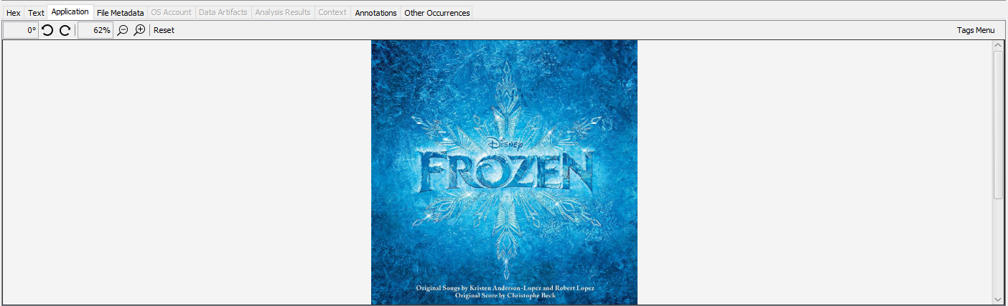
Jpeg files on vm image

Slide 24
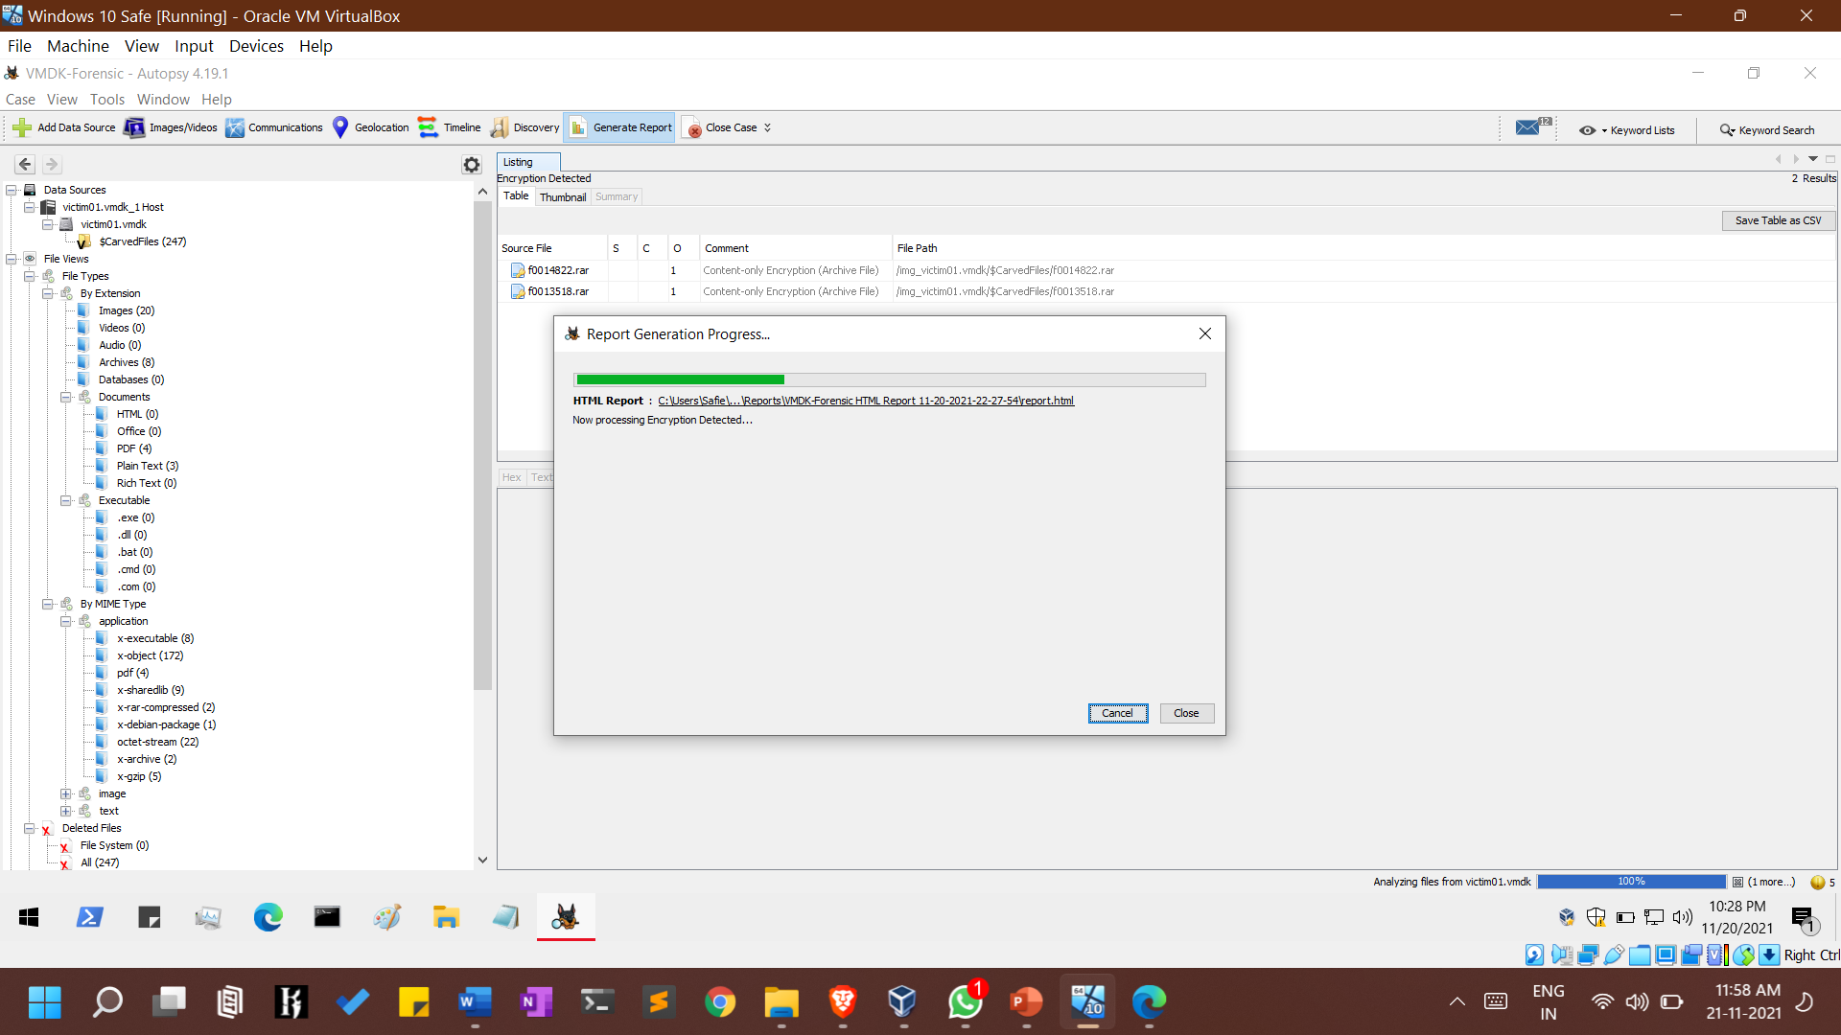
Generating Reports

Slide 25
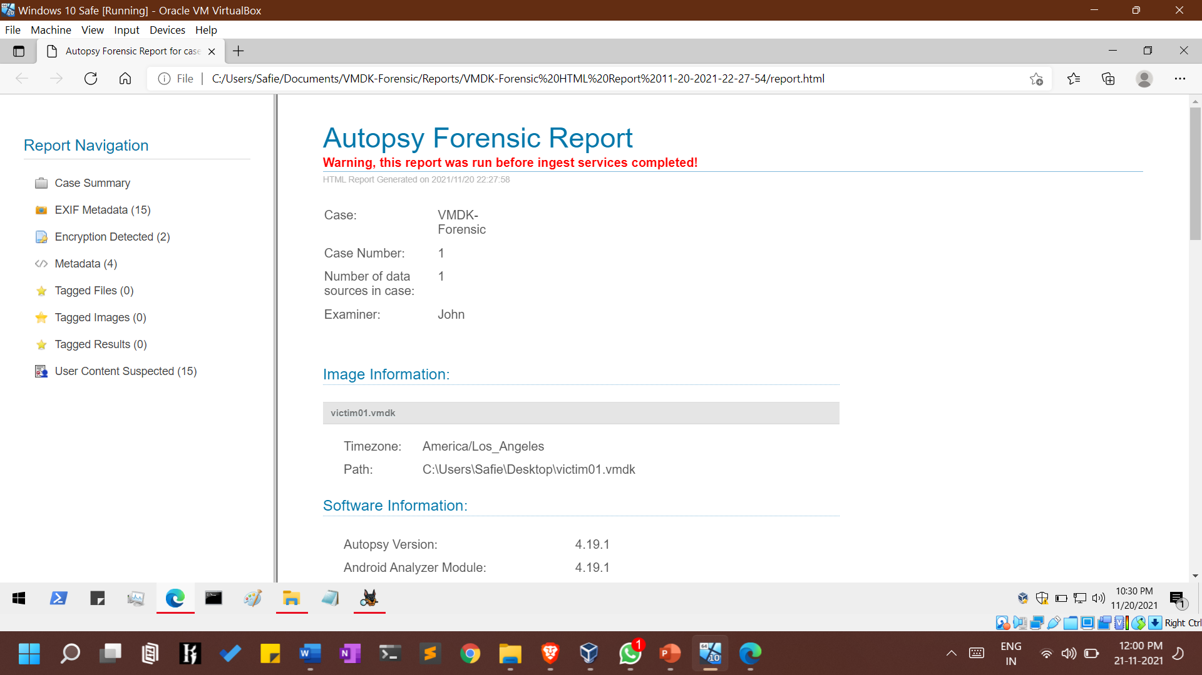

Slide 26
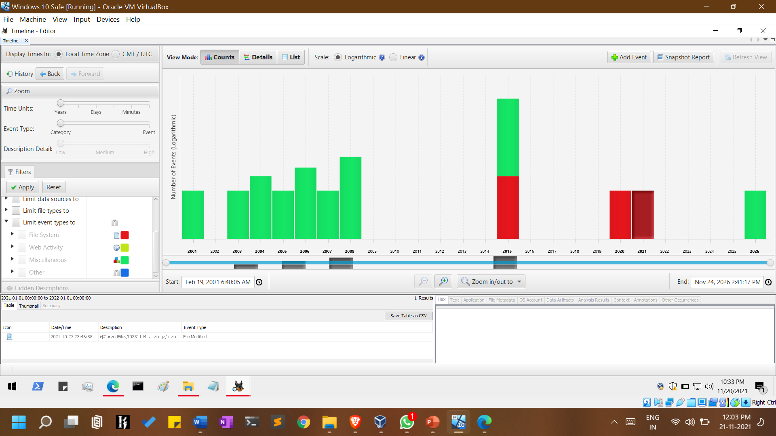
Timeline Viewing

Slide 27
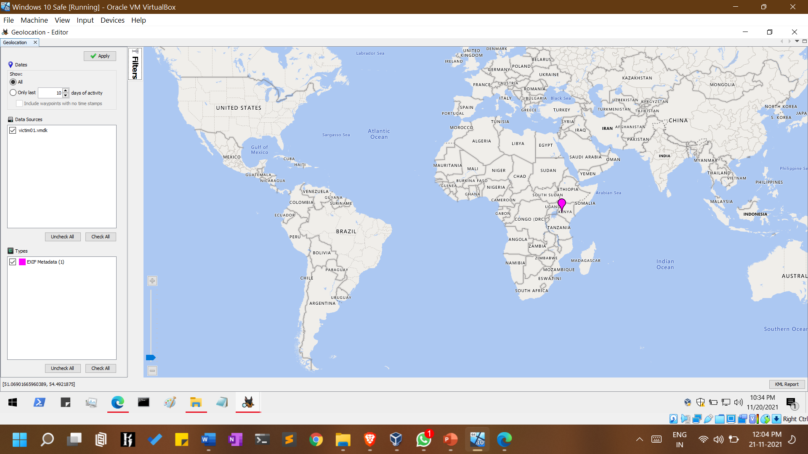
Geo-location from meta data of images

Slide 28
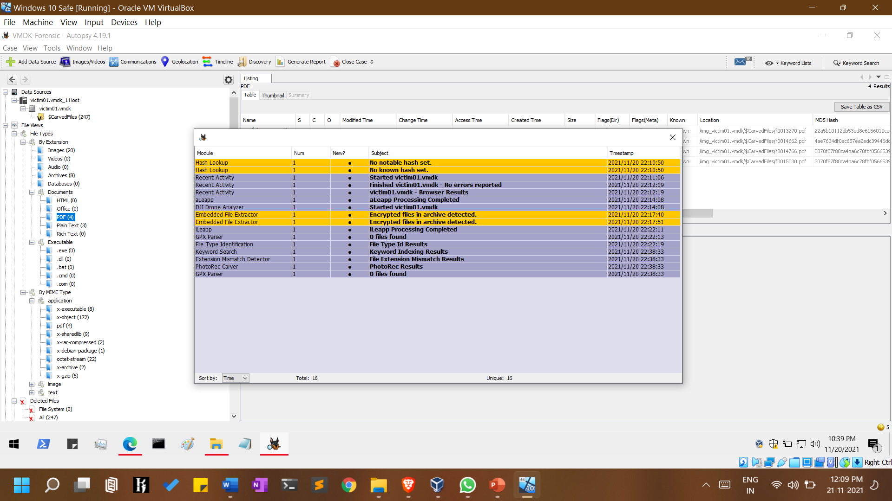

Slide 29
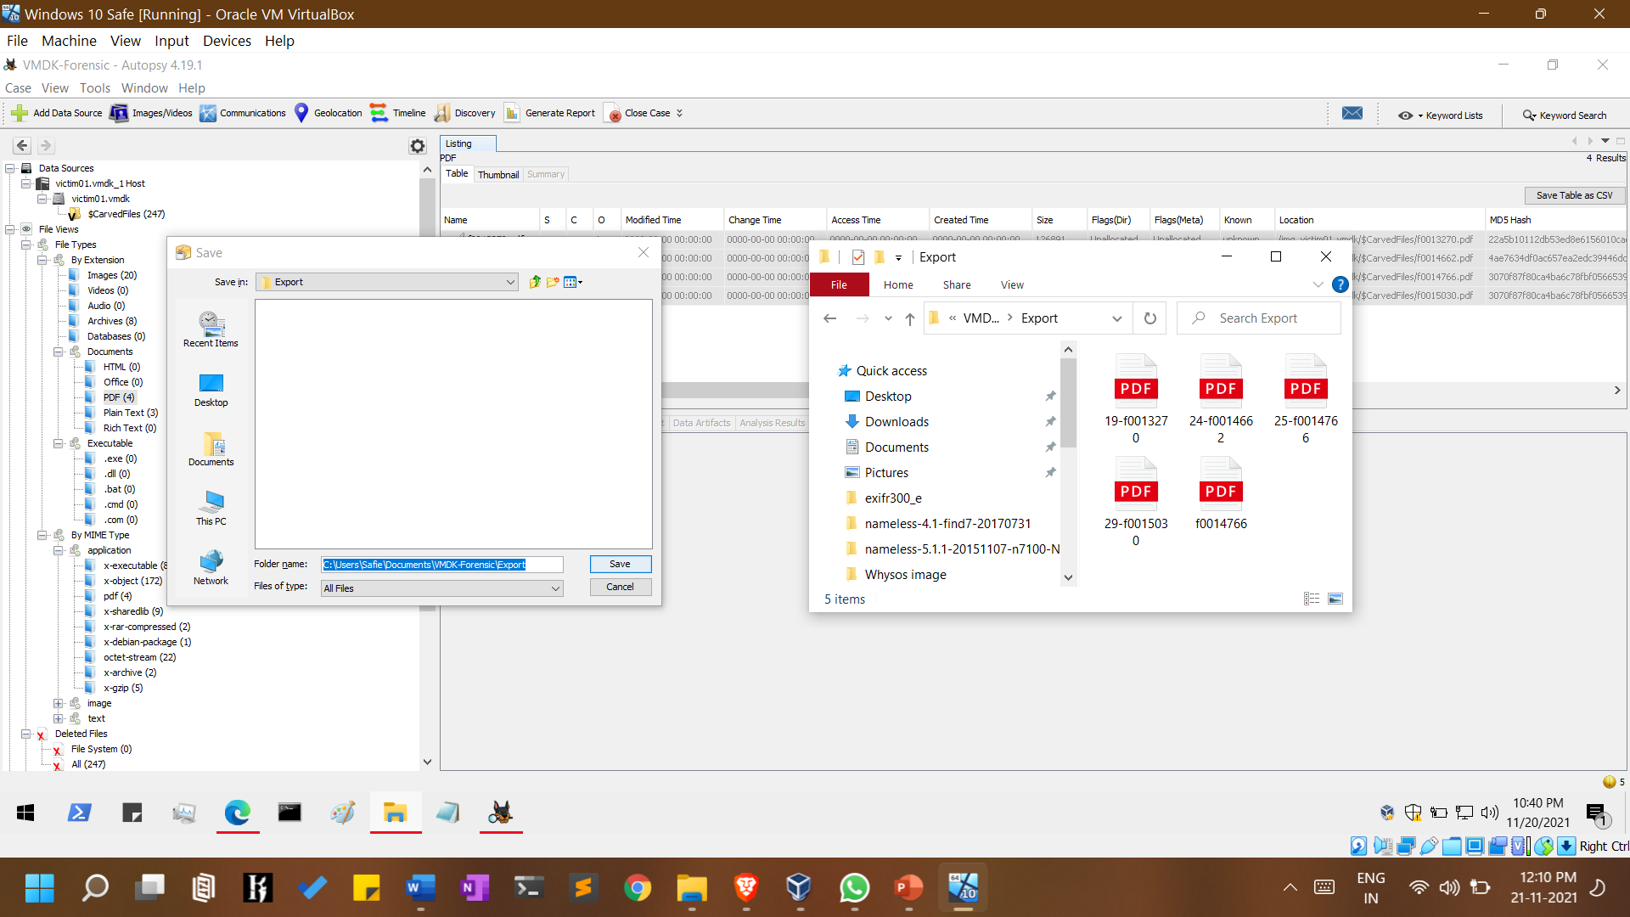
Extracting Files from vmdk image for further analysis

Slide 30
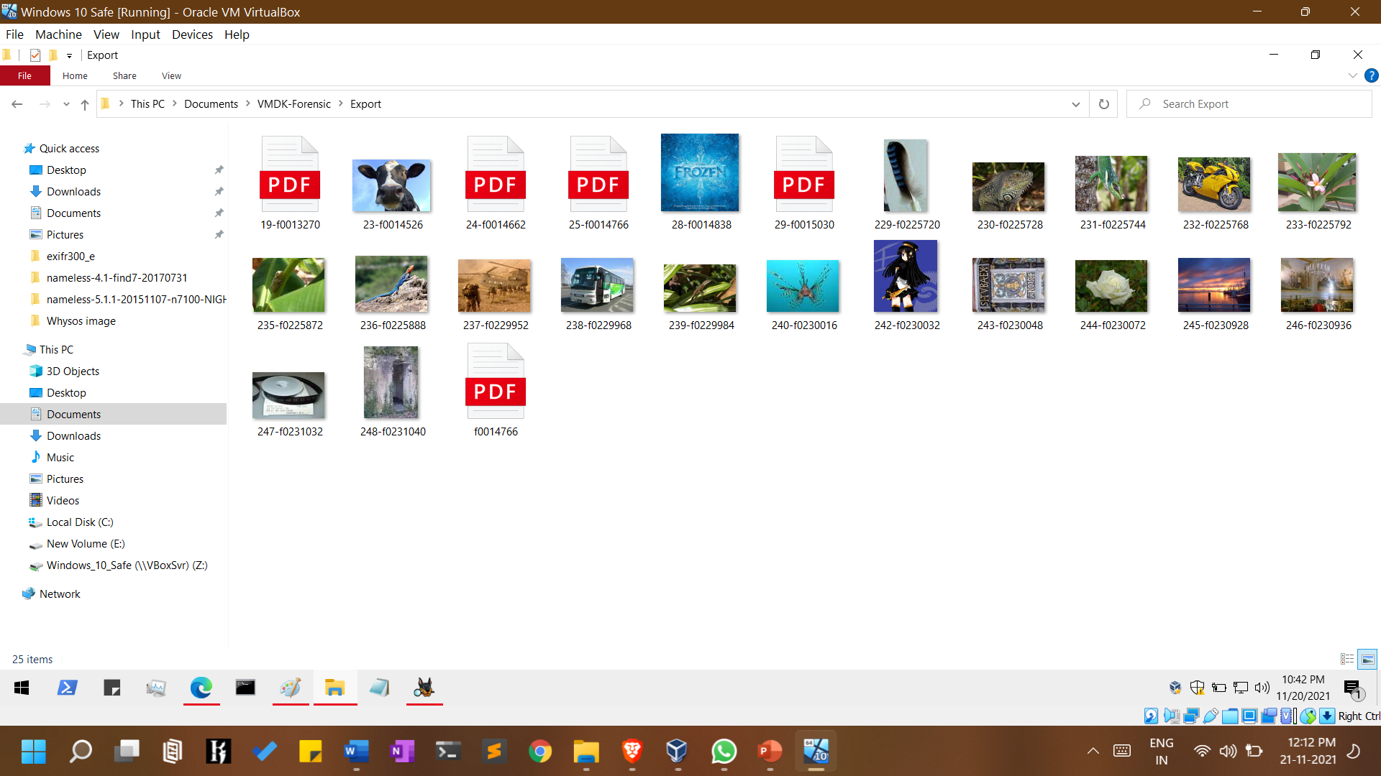
Extracted Files

Slide 31
Ftkimager

Slide 32
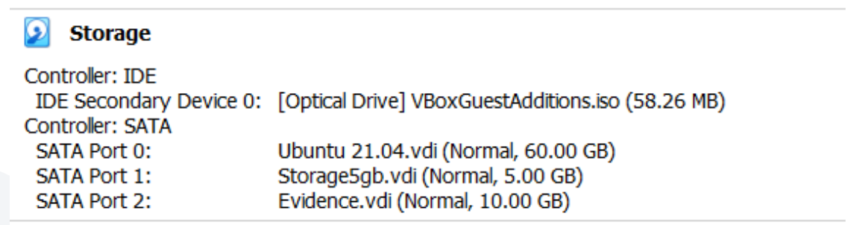
Case 2 : Victim Snapshot of Ubuntu VDI

Slide 33
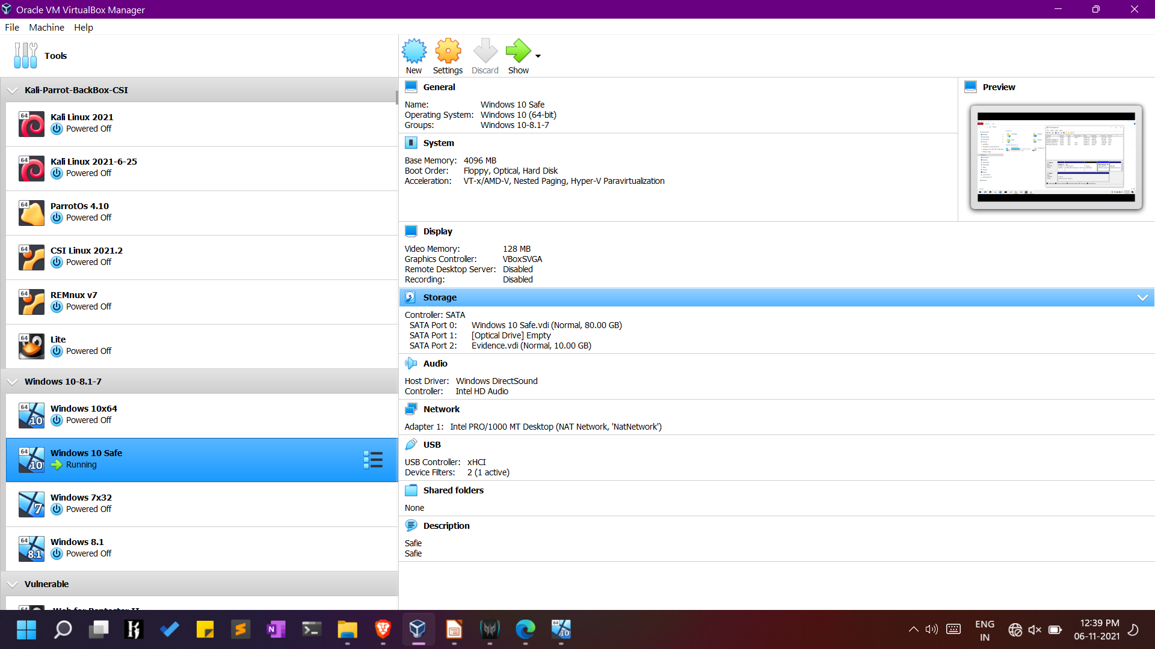
Case: Windows 10 for Forensics

Slide 34
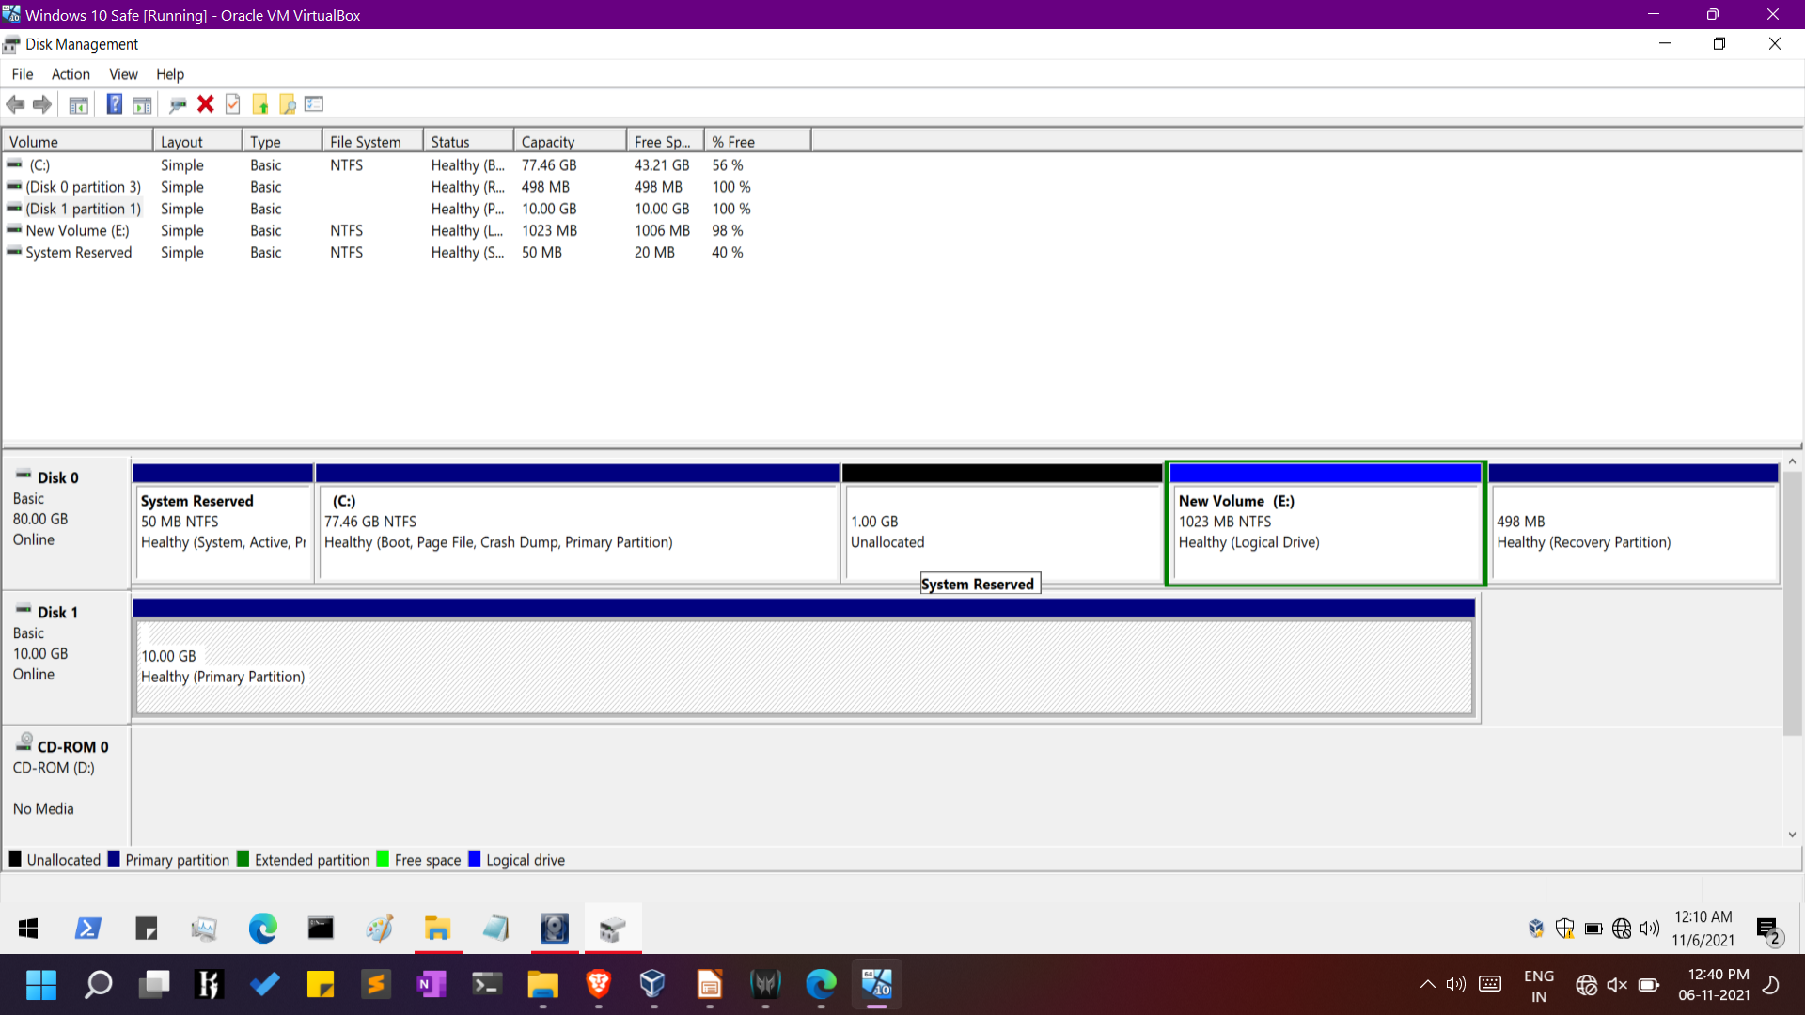
Suspects Evidence Disk(10gb) -> Disk 1(10gb)

Slide 35
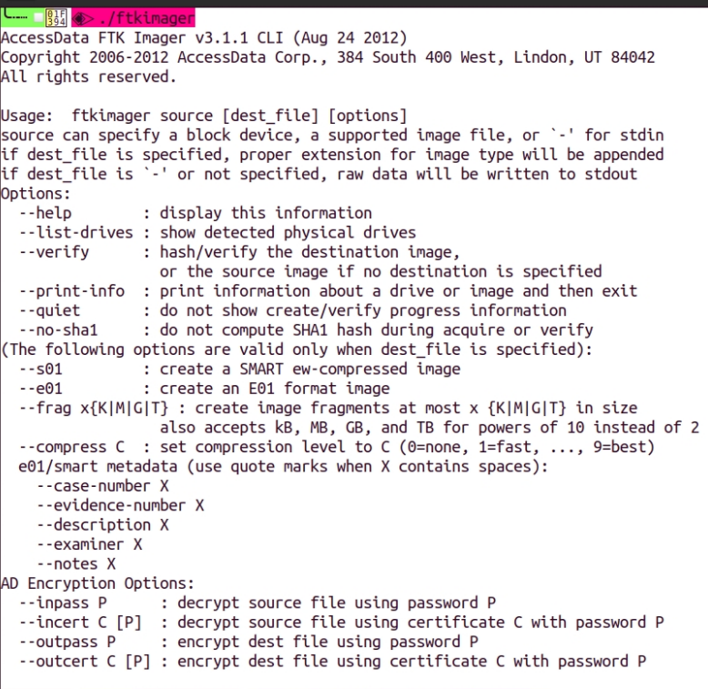
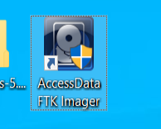
FTK Imager ie Forensic Toolkit
Cmd Line

Slide 36
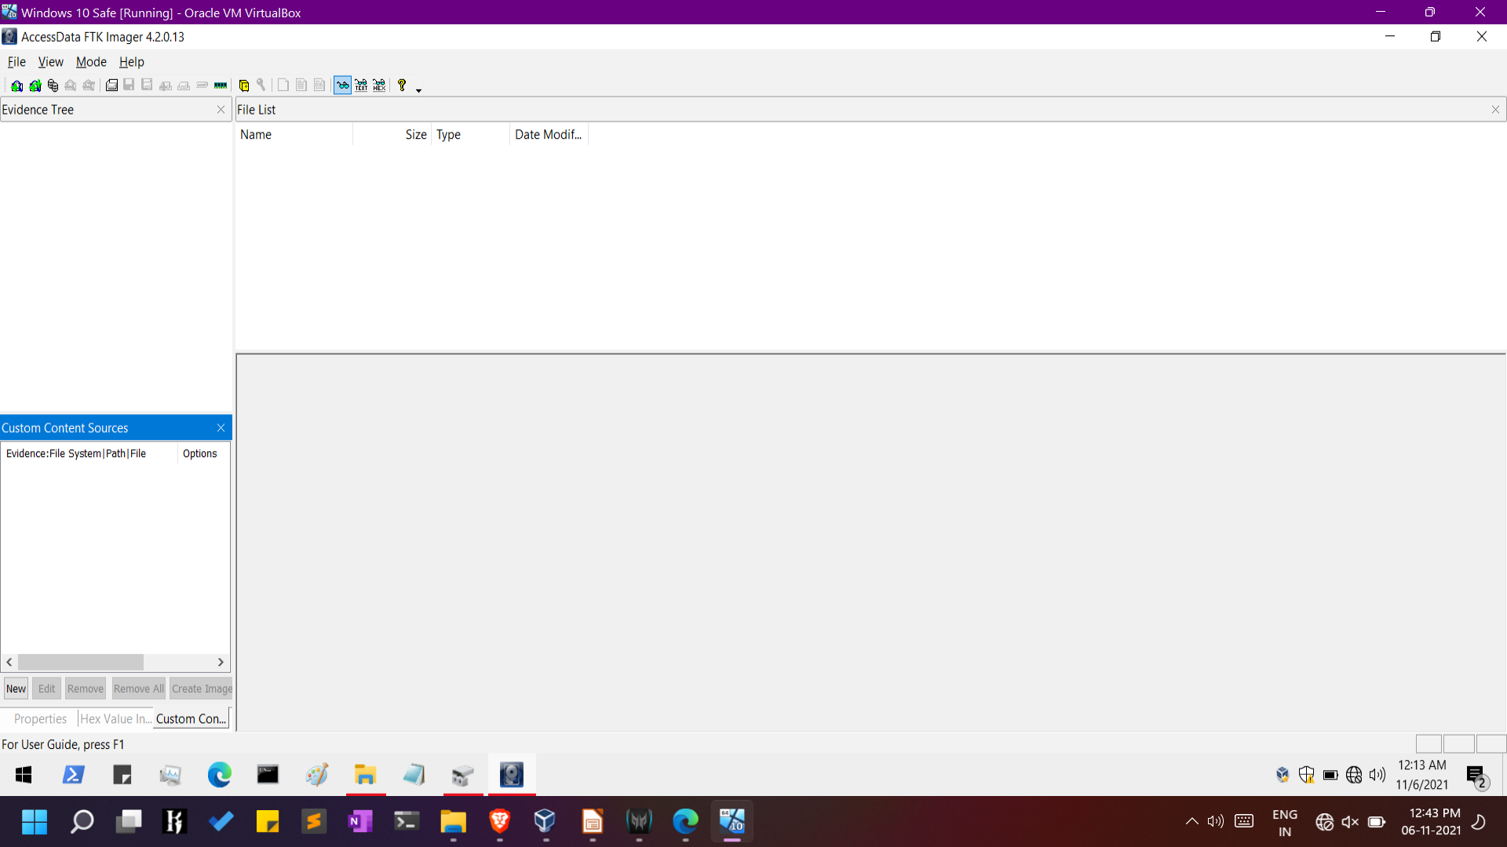
FTK GUI

Slide 37
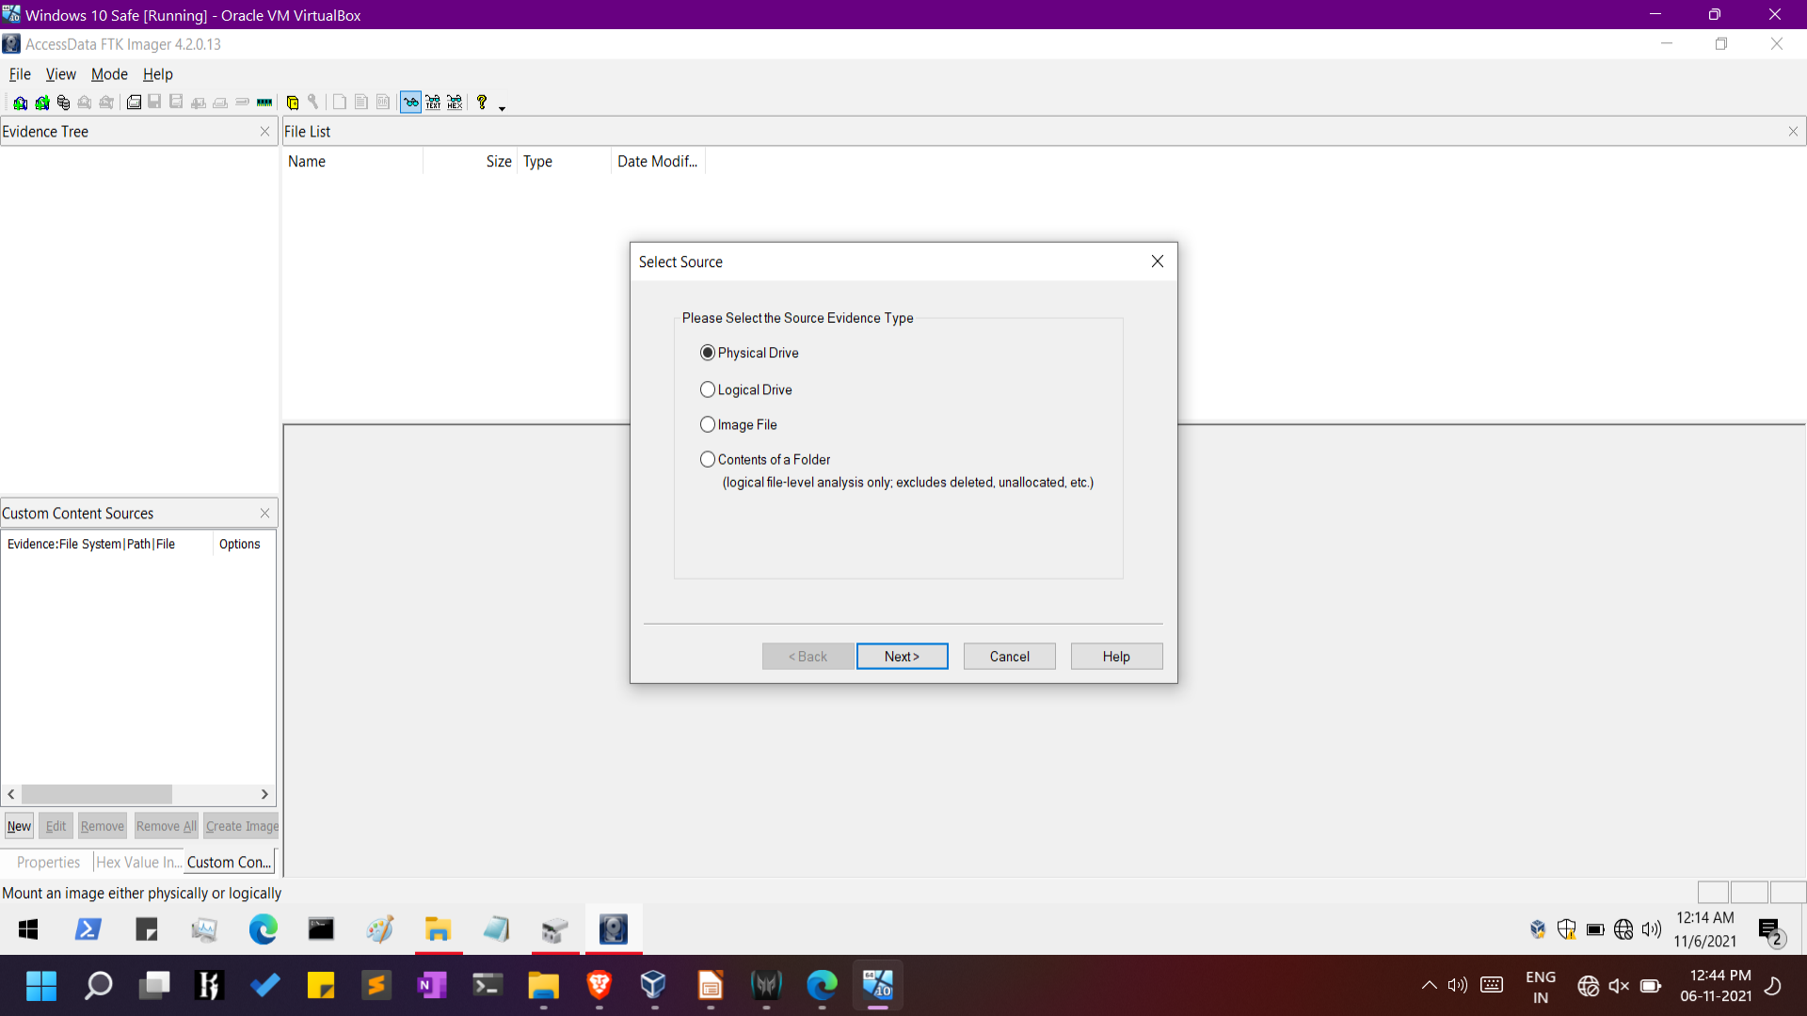
Adding Evidence

Slide 38
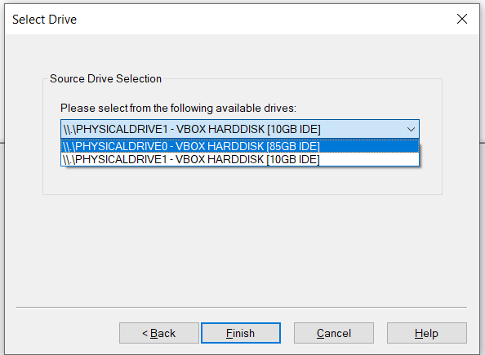
Physical Drive 1 i.e.
Evidence Disk

Slide 39
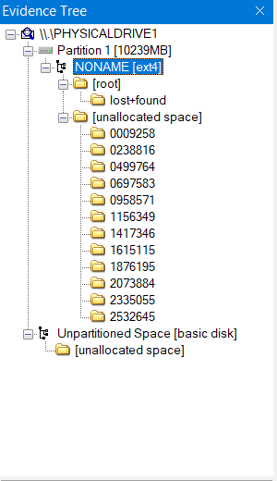
Evidence Tree

Slide 40
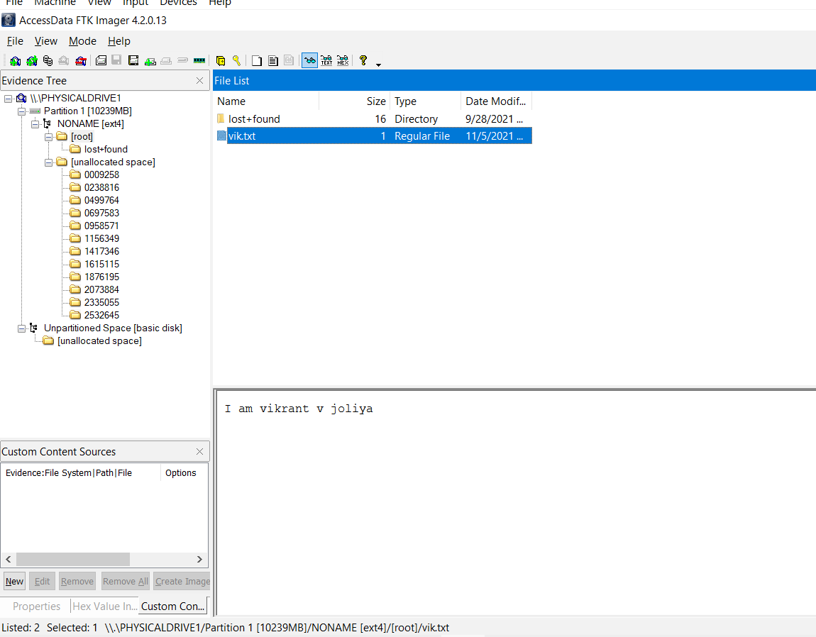
Recovering Data from Suspects VDI

Slide 41
REFERENCE
https://ostoday.org/linux/how-do-i-mount-a-vdi-file-in-linux.html
https://community.mis.temple.edu/mis5216sec701fall2020/week-6-project-portfolio-management/
https://www.exterro.com/forensic-toolkit
https://csilinux.com/
https://www.hackingarticles.in/comprehensive-guide-on-ftk-imager/
https://www.hackingarticles.in/how-to-recover-deleted-from-raw-image-using-ftk-imager-and-recover-my-file/
https://www.hackingarticles.in/how-to-convert-encase-ftk-dd-raw-vmware-and-other-image-file-as-windows-drive/

Slide 42
THANK YOU

